Slide 1
Detecting Backdoor Attacks via Similarity in Semantic Communication Systems
Ziyang Wei, Yili Jiang, Jiaqi Huang, Fangtian Zhong, Sohan Gyawali
1
1
Ziyang Wei, Yili Jiang, Jiaqi Huang, Fangtian Zhong, Sohan Gyawali."Detecting Backdoor Attacks via Similarity in Semantic Communication Systems" International Symposium on Intelligent Computing and Networking.ISICN.2025

Slide 2
Outline
Introduction
Related Work
System Model
The Proposed Defense Mechanism
Experiment
Conclusion
Future Work
2

Slide 3
Introduction Related Work System Model The Proposed Defense Mechanism Experiment Conclusion Future Work
3

Slide 4
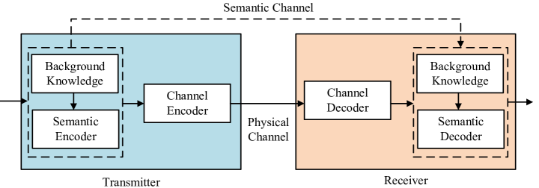
Semantic Communication System
What is Semantic Communication?
Encoder extracts semantic features (images → feature vectors).
Feature vectors transmitted over a communication channel.
Decoder reconstructs the original information.
4

Slide 5
Semantic Communication
Why is Semantic Communication?
Transmits "meaning" instead of raw data.
Transmit key info only, no need to transmit all original data.
Lower Bandwidth cost.
Used in IoT, autonomous driving, AR/VR applications.
→ improves efficiency
5
Notes:
Do not transmit all original data, discard redundant data, and only transmit key information that can completely restore the original data.Since semantic communication transmits key information instead of all data, the bandwidth requirement is much lower than traditional communication.

Slide 6

Backdoor Attack
What are Backdoor Attacks?
Inject poisoned samples with hidden triggers.
Manipulating inference results.
The model behaves normally for clean samples, misclassifies triggered samples.
The model will classifier the clean samples(with trigger) as the target class.
trigger
Stop Sign
Yield Sign
6

Slide 7
Introduction Related Work System Model The Proposed Defense Mechanism Experiment Conclusion Future Work
7

Slide 8
Existing Defense Mechanisms & Limitations
Text encoder
Image encoder
Neuron Pruning[1]:
Removes malicious neurons.
Affects clean sample accuracy.
Semantic Shield[2]:
Aligns image-text pairs.
Limited to paired data formats.
Text Information
Compare
Image Information
8
[1] Yuan Zhou, et al."Backdoor attacks and defenses on semantic-symbol reconstruction in semantic communications" In ICC 2024 - IEEE International Conference on Communications.
[2] Alvi Md Ishmam, et al."Semantic shield: Defending vision-language models against backdooring and poisoning via fine-grained knowledge alignment." In 2024 IEEE/CVF Conference on Computer Vision and Pattern Recognition (CVPR).

Slide 9
Introduction Related Work System Model The Proposed Defense Mechanism Experiment Conclusion Future Work
9

Slide 10
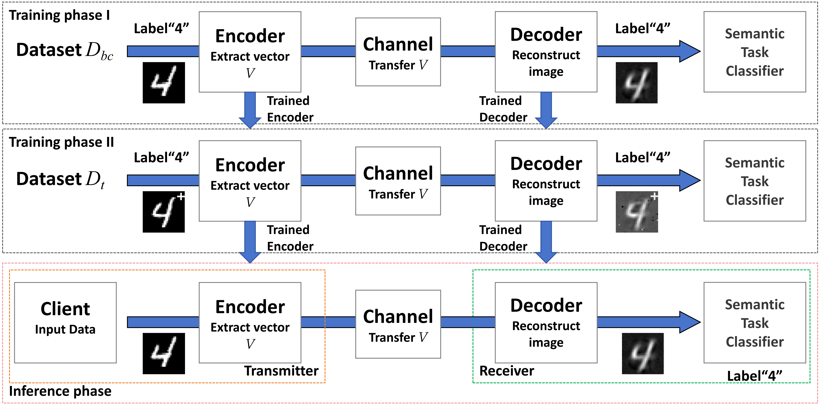


System model
The semantic communication system consists of three phases: Training Phase I, Training Phase II, and the Inference Phase.
Training Phase I: The system is pre-trained on a clean dataset ($D_{bc}$) to generate an initial model.
Training Phase II: Users upload their collected dataset ($D_{t}$) to further refine the model. If $D_{t}$ contains poisoned samples, a backdoor attack can be introduced at this stage.
10

Slide 11
System model
The semantic communication system consists of three phases: Training Phase I, Training Phase II, and the Inference Phase.
Inference Phase: The final model is deployed for real-time data reconstruction and classification.
11

Slide 12
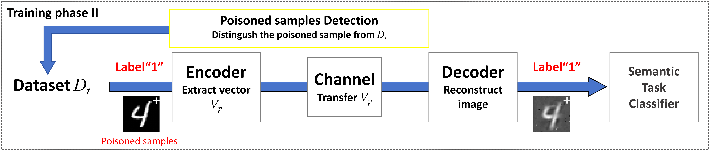
Backdoor Attack Model
Training Phase II: Injects poisoned samples.
Inference Phase: Model misclassifies inputs with the hidden trigger.
12

Slide 13
Introduction Related Work System Model The Proposed Defense Mechanism Experiment Future Work Conclusion
13

Slide 14
Proposed Defense Mechanism
Design Goal
No model modification required.
No data format constraints.
Use semantic similarity to detect poisoned samples.
Mahalanobis distance: A method for measuring the distance between a data point and the center of the data distribution.
14

Slide 15
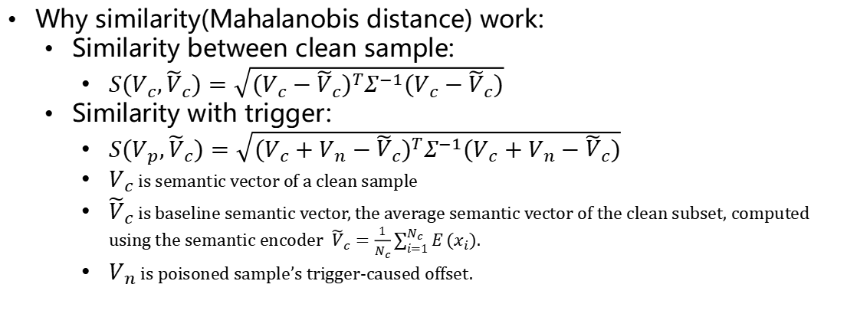
Proposed Defense Mechanism
Why similarity(Mahalanobis distance) work:
Similarity between clean sample:
$S(V_{c},{\tilde{V}}_{c})=\sqrt{(V_{c}−{\tilde{V}}_{c})^{T}Σ^{−1}(V_{c}−{\tilde{V}}_{c})}$
Similarity with trigger:
$S(V_{p},{\tilde{V}}_{c})=\sqrt{(V_{c}+V_{n}−{\tilde{V}}_{c})^{T}Σ^{−1}(V_{c}+V_{n}−{\tilde{V}}_{c})}$
$V_{c}$ is semantic vector of a clean sample
${\tilde{V}}_{c}$ is baseline semantic vector, the average semantic vector of the clean subset, computed using the semantic encoder ${\tilde{V}}_{c}=\frac{1}{N_{c}}\sum_{i=1}^{N_{c}}{E}(x_{i})$.
$V_{n}$ is poisoned sample’s trigger-caused offset.
15

Slide 16
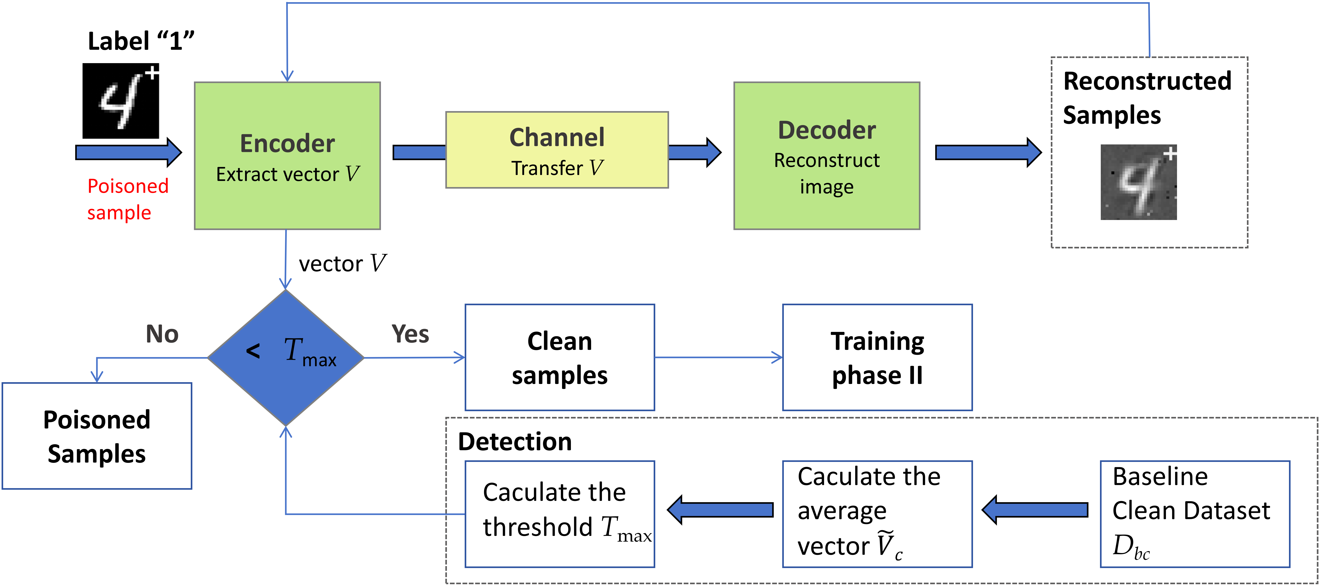
Detection
Apply threshold-based classification
If similarity < threshold → clean
If similarity ≥ threshold → poisoned
After Training phase I,
before Training phase II.
drop the poisoned samples
keep the clean samples
16

Slide 17
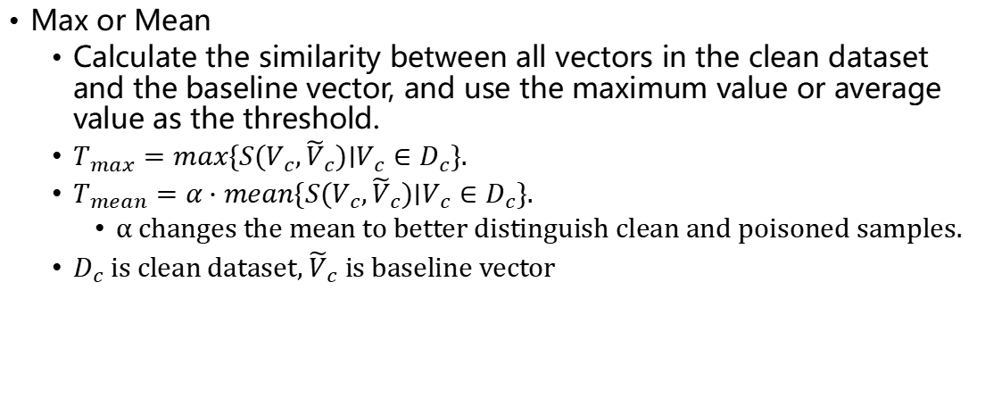
Threshold Determination
Max or Mean
Calculate the similarity between all vectors in the clean dataset and the baseline vector, and use the maximum value or average value as the threshold.
$T_{max}=max\{S(V_{c},{\tilde{V}}_{c})∣V_{c}∈D_{c}\}.$
$T_{mean}=α⋅mean\{S(V_{c},{\tilde{V}}_{c})∣V_{c}∈D_{c}\}.$
α changes the mean to better distinguish clean and poisoned samples.
$D_{c}$ is clean dataset, ${\tilde{V}}_{c}$ is baseline vector
17

Slide 18
Introduction Related Work System Model The Proposed Defense Mechanism Experiment Future Work Conclusion
18

Slide 19
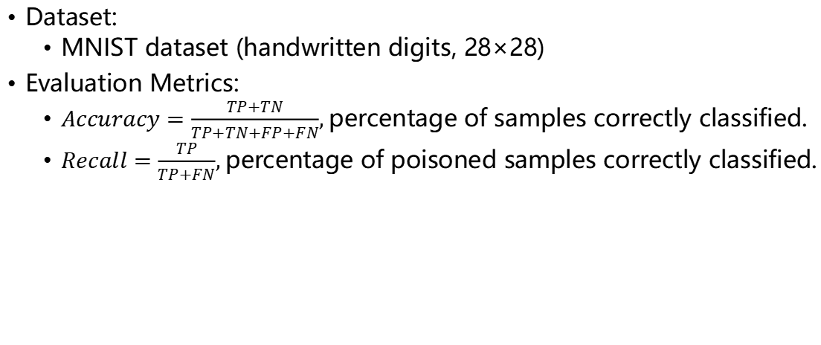
Experiment Setting
Dataset:
MNIST dataset (handwritten digits, 28×28)
Evaluation Metrics:
$Accuracy=\frac{TP+TN}{TP+TN+FP+FN}$, percentage of samples correctly classified.
$Recall=\frac{TP}{TP+FN}$, percentage of poisoned samples correctly classified.
19

Slide 20
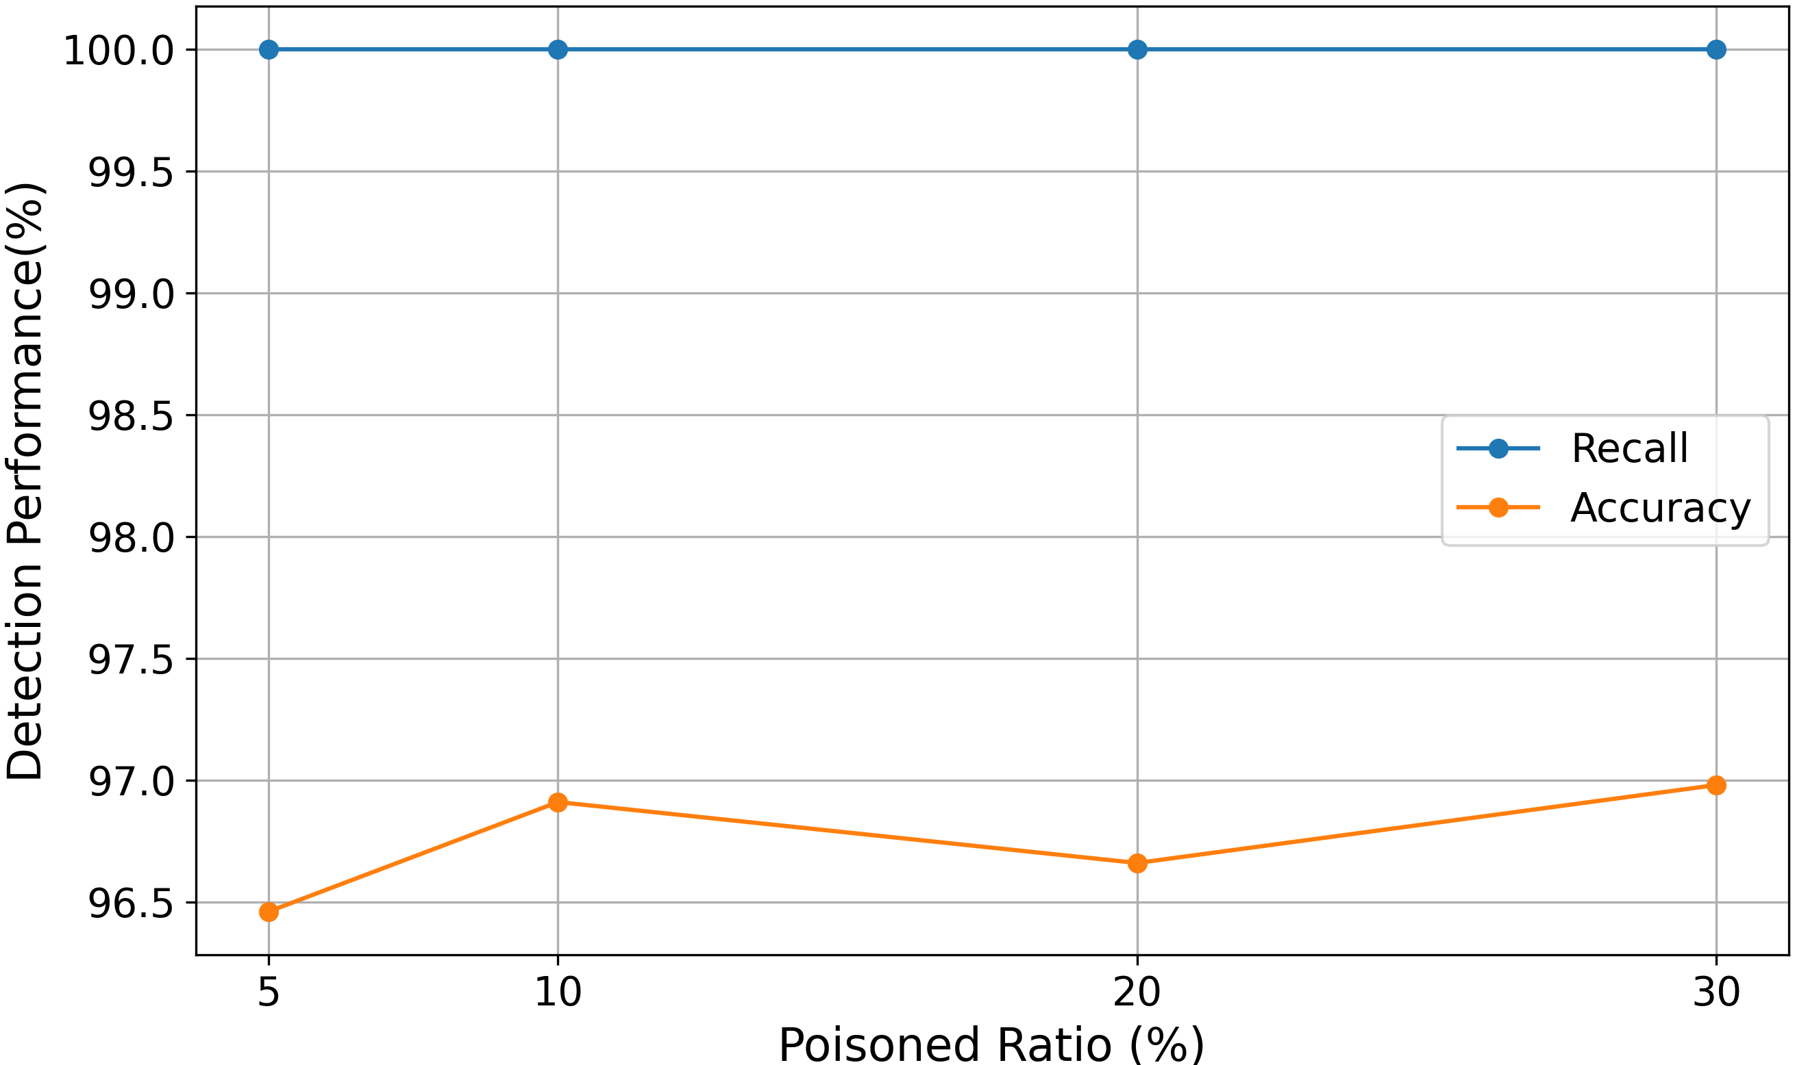
Experiment Results
Directly using the mean value does not reflect the boundary between clean and poisoned well
Mean-Threshold Approach (α=2)
Achieves perfect recall (100%) at all poisoning ratios.
Accuracy remains high (96.46% - 96.98%).
Effectively detects poisoned samples without misclassifying clean samples.
20

Slide 21
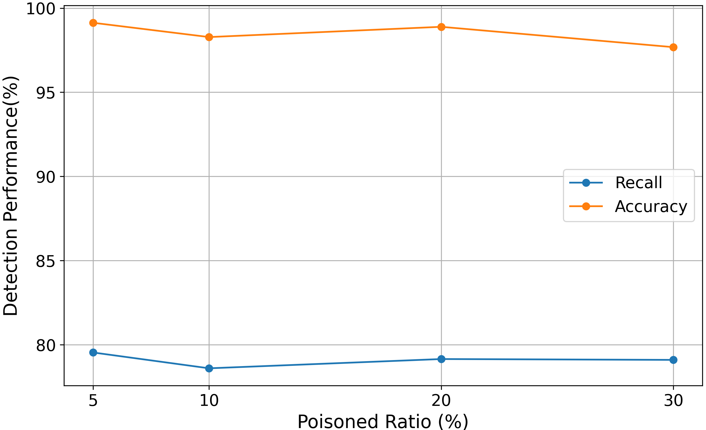
Experiment Results
Max-Threshold Approach
High accuracy (99.13%) but lower recall (around 79%).
Directly using the max-threshold cannot effectively distinguish poisoned samples from clean samples.
The recall value is too low compared to the mean-threshold.
21

Slide 22
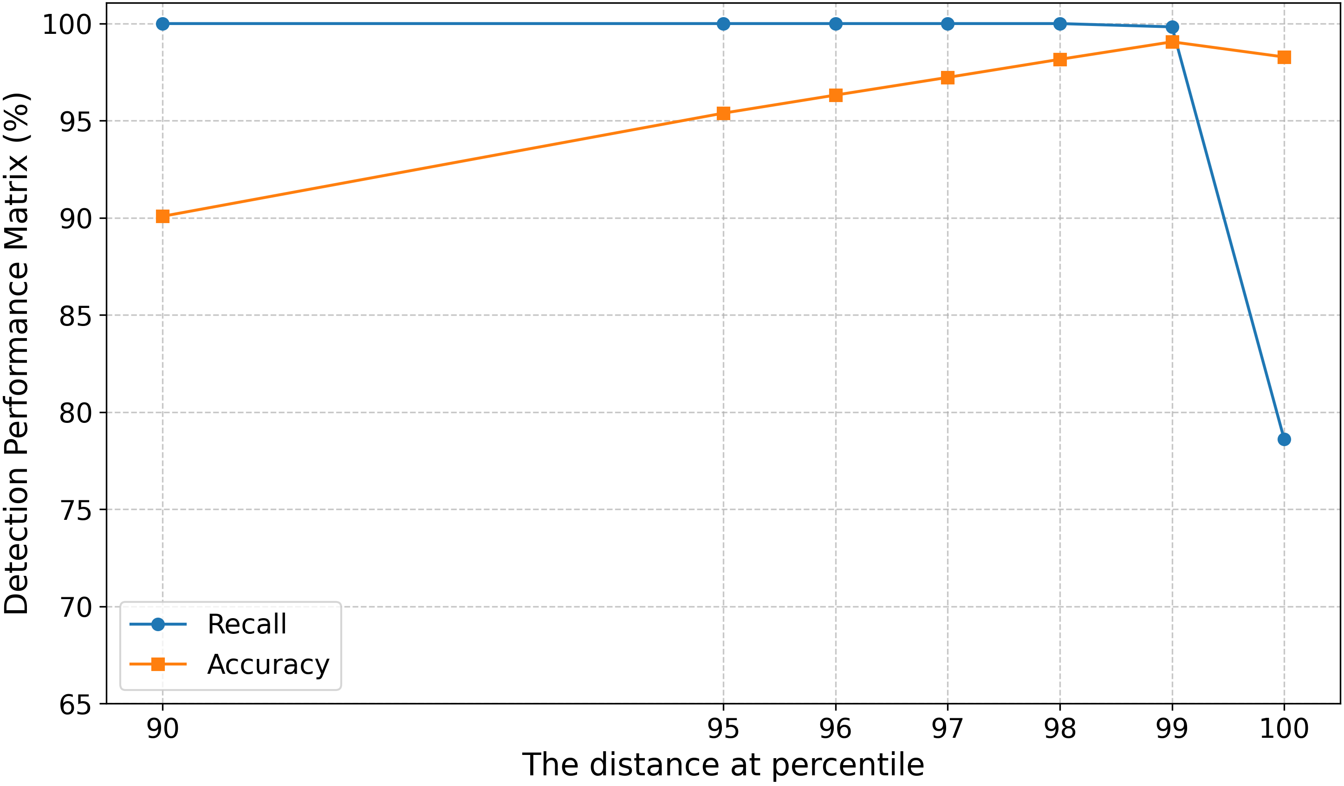
Experiment Results
Best performance for max threshold
Optimized Max-Threshold (Percentile-Based Adjustment)
Accuracy improves steadily (90.08% → 99.06%) when adjusting the threshold（90 → 99）.
At the 100% percentile, recall drops to 78.6%, showing that the 100% max similarity value is not best choice.
99% is the best choice in our experiment.
22

Slide 23
Introduction Related Work System Model The Proposed Defense Mechanism Experiment Conclusion Future Work
23

Slide 24
Conclusion
This paper proposed a defense mechanism to detect Backdoor attacks by semantic similarity.
The key contributions include:
Develop defense strategies without model modification & format requirement:
Max-similarity thresholds
Mean-similarity thresholds
Comprehensive experiments under various poisoning ratios.
High detection accuracy and recall, confirming the defense mechanism's ability to detect poisoned samples.
24

Slide 25
Introduction Related Work System Model The Proposed Defense Mechanism Experiment Conclusion Future Work
25

Slide 26
Future Work
Extend to multi-modality semantic communications, integrating text, image, video, audio, ect.
Investigate dynamic thresholding for adaptive detection.
Explore other security and privacy threats in semantic communications system.
26

Slide 27
Thank you!
27

Slide 28
Backup
Why is Mahalanobis distance?
Try Cosine Similarity and Manhattan Distance as semantic similarity.
Since Cosine Similarity focuses on the distance between the directions of two vectors, and Manhattan Distance focuses on calculating the sum of the absolute differences between vector components, it is not suitable for high-dimensional data.
Detecting poisoned samples is detecting abnormal data, and Mahalanobis distance is usually used to detect abnormal data.
28

Slide 29
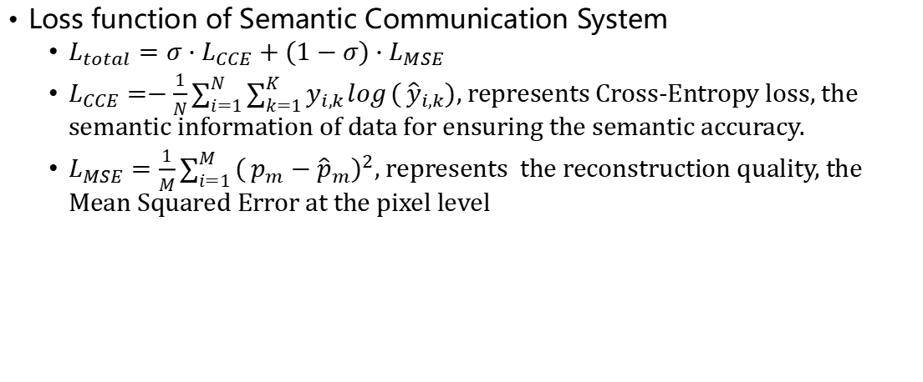
Backup
Loss function of Semantic Communication System
$L_{total}=σ⋅L_{CCE}+(1−σ)⋅L_{MSE}$
$L_{CCE}=−\frac{1}{N}\sum_{i=1}^{N}{\sum_{k=1}^{K}{y_{i,k}}}\log{(}{\hat{y}}_{i,k})$, represents Cross-Entropy loss, the semantic information of data for ensuring the semantic accuracy.
$L_{MSE}=\frac{1}{M}\sum_{i=1}^{M}{(}p_{m}−{\hat{p}}_{m})^{2}$, represents the reconstruction quality, the Mean Squared Error at the pixel level
29
Notes:
title, explain phyical meaning pixel level eg, parameter definition, change to 图片来表的一些内容, not only the text, 放在backup page

